Slide 1
Product Management
Prof. Dr. Dirk Riehle
Friedrich-Alexander University Erlangen-Nürnberg
COSS C03
Licensed under CC BY 4.0 International
Notes:
It is Friedrich-Alexander University Erlangen-Nürnberg – FAU, in short.
Corporate identity wants us to say “Friedrich-Alexander University”.

Slide 2
Agenda
Product management in context
Software features
Feature differentiation
The open core model
IP rights management
Cloud computing challenges
Commercial open source life-cycle

Slide 3
The Commercial Open Source Challenge (Recap)
Structure product and services so that you
  Maximize conversion to paying customer
  While benefiting from user community
  And keeping the competition at bay

Slide 4
1. Product Management in Context

Slide 5
Product Management in Context (Recap)
Management
Sales and Marketing
Product
Management
(Inbound
Marketing)
Engineering
Other
(HR, Office, Finances, ...)
Sales
(Outbound)
Marketing
Development
Support

Slide 6
The Main Questions for Product Management to Answer
What / why / when should be doing it?
  For the company (strategic product management)
  For the product (technical product management)
Strategic product management
  Performs market research
  Defines the opportunity
Technical product management
  Performs market research
  Specifies the product

Slide 7
The Role of the Product Manager
CEO of the product
  Holds overall responsibility for the product (including revenue responsibility)
Voice of the customer
  Channels market requirements towards development

Slide 8
Who is a Product Manager?
Solo entrepreneur
Team-based startup
PM
EM
SD
PM
EM
SD
Roles
Posts
Roles
Posts
Founder
CPO
CTO
Mature vendor
PM = Product manager (strategic + technical)
SPM = Strategic product manager
TPM = Technical product manager
CPO = Chief Product Officer
EM = Engineering manager
VPE = VP of engineering
CTO = Chief Technology Officer
SD = Software developer
SPM
TPM
EM
SD
Roles
Posts
PM
EM
SD

Slide 9
Project vs. Product Manager
A project manager
  Manages projects (including people)
A product manager
  Defines products, may lead projects

Slide 10
Product Management is an Ongoing Process
Opportunity
Segmentation
Partnerships
Architecture
Roadmap
...
Strategic product management
Technical
product management
Releases
Requirements
User experience
Compliance
…

Slide 11
2. Software Features

Slide 12
Tools of the Trade
Vision
Glossary
Features

Slide 13
Why Written Communication?
Writing helps you …
  Discipline your thinking
  Uncover errors
  Identify omissions
  Avoid repeating yourself
  Communicate asynchronously
  Multiply your powers

Slide 14
Product Vision
A product vision …
  Captures the essence of the product and the reasons for its existence
    As the business value it provides to users
  Names users and customers
    Embodies the core structure of an underlying business model
  Is inspiring (inspires users / customers)
  Is timeless (not bound to a schedule)
  Is focused (reduces to the essentials)
  Is a decision aid (the ultimate arbiter)

Slide 15
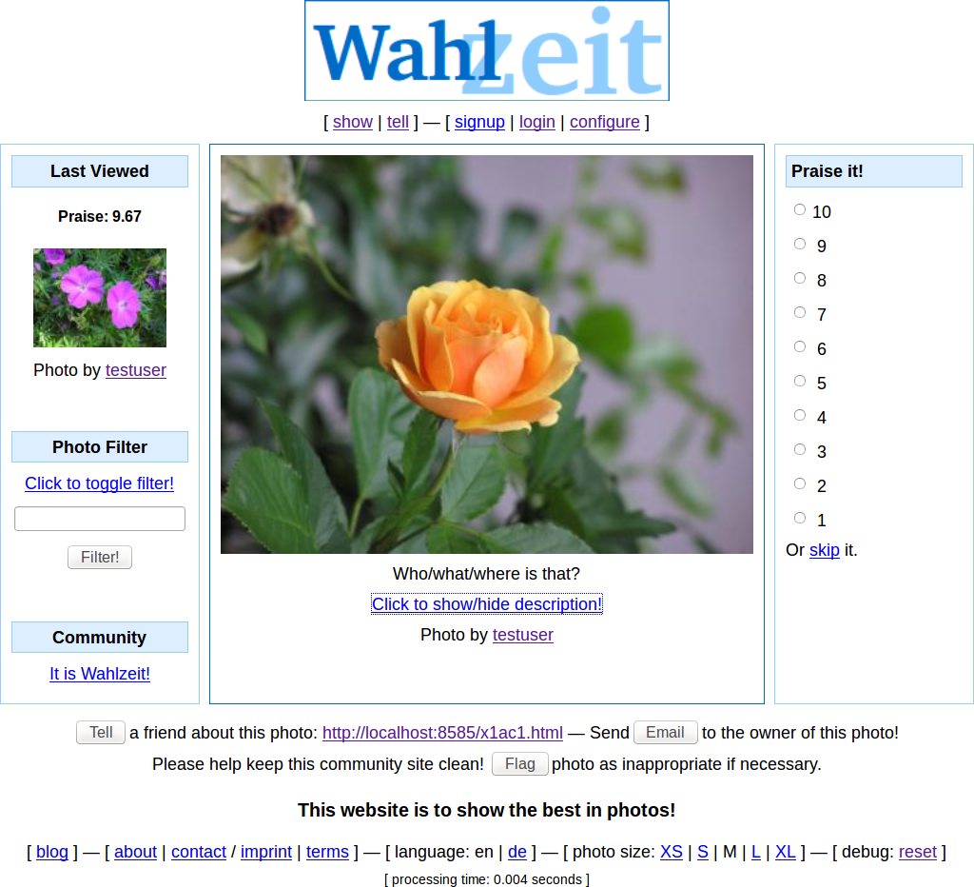

Slide 16
Example Product Vision
Flowers Product Vision
  The Flowers social network helps flower enthusiasts worldwide to connect with each other and enjoy following their favorite hobby online. Centered on showing and rating favorite flower photos, it inspires growing and presenting ever more beautiful flowers. With a highly engaged user community, Flowers is the best place for producers and sellers of gardening supply to reach out to customers and engage with them. Such engagement involves understanding flower enthusiasts’ needs around gardening supplies and selling to them.

Slide 17
Product (Domain) Glossary
A domain glossary …
  Is a list of concepts and their definition from the product being developed
  Is the missing link between the vision and the requirements
  Is a “poor man’s approach” to a domain model
A glossary term …
  Is a domain concept with a clearly defined name
  Has a crisp “is a” definition, followed by secondary properties
  Is defined using a single sentence, at max. a paragraph

Slide 18
Example Domain Glossary
Term | Definition
Photo | A photo is a digital image provided in either JPEG or PNG format. It must be at least of size 512x512 pixel.
Flower photo | A flower photo is a photo of one or two flowers. If more flowers are visible and in-focus, the photo is a flower bed photo.
Flower bed photo | A flower bed photo is a photo of three or more flowers in-focus. If less than three flowers are visible, it is a flower photo.
Photo Rating | A photo rating is a numerical value in the range of 1..10 that expresses the appreciation of a photo numerically. 1 is lowest, 10 is highest.
Individual photo rating | An individual photo rating is a photo rating that expresses a particular individual's appreciation of a photo at a particular point in time.

Slide 19
Connecting Vision with Features Through Glossary
Vision
Glossary
Features

Slide 20
Product Feature
A (software) feature is …
  A distinguishing characteristic of a software item (for example, performance, portability, or functionality) [IEEE 829]
Also, in Scrum
  An epic is …
    A large feature awaiting break-down into smaller features; it acts as a placeholder for these smaller features
  A (user) story is …
    A feature presented using a the user-story-pattern that is small enough to be implemented in a sprint
Refactoring
Bug report

Slide 21
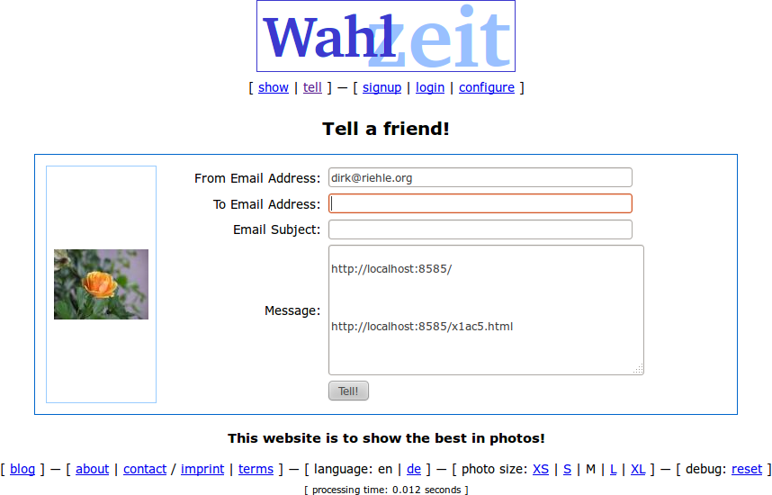

Slide 22
User Story (Sentence Template)
As a
<persona>
I need
<function>
so that
<value>
As a visitor, I can tell a friend about Flowers to share my enthusiasm for the service

Slide 23
3. Feature Differentiation

Slide 24
The Product Management Challenge (Recap)
Structure product and services so that you
  Maximize conversion to paying customer
  While benefiting from user community
  And keeping the competition at bay

Slide 25
Which Feature Goes Where? (Recap)
Community edition
  Core product
    Core software
      Provided under an open source license
    Some complementary artifacts
    Self-help services
Commercial edition
  Core product
    Core software
      Provided under a commercial license
    Additional functionality
    Complementary artifacts
    Self-help services
  Basic product = core product +
    Fitness for use / certification
    Indemnification
    Support services
  Whole product = basic product +
    Training
    Consulting
    Operations

Slide 26
A Commercial Open Source Feature Classification
Non-differentiating
  The feature is competitively not differentiating and readily available in community open source
Reason-to-use
  Users come to your software, because the feature is not ubiquitous
Reason-to-buy
  Users upgrade to paying customers to receive this feature

Slide 27
Open / Closed Software Feature Differentiation
}
?
Other
products
Your product
(Reason-to-buy features)
Commercial open source
(Reason-to-use features)
Layers
Community open source
(Non-differentiating features)

Slide 28

How to Think About Feature Differentiation
closed
Cloud
operations
at scale
Technical Domain
Complementarity
open
Application
Domain
Enterprise
readiness
features
Consumer
Enterprise
Market

Slide 29

Yugabyte 2020 (Example Feature Differentiation)
closed
yugabyte cloud
Technical Domain
Complementarity
open
Application
Domain
Consumer
Enterprise
Market

Slide 30
4. The Open Core Model

Slide 31
Intellectual Property Modularity
Intellectual property (IP) modularity
  The practice of splitting software into modules of different licenses
Open core model
  A particular form of IP modularity where there is
    An “open” core available under an open source license and
    Functional extensions of the core available only under a commercial license
C1
(license 1)
C2
(license 2)
Closed
features
Open
core

Slide 32
What do Open Core Users Worry About?
That the vendor
  Withholds critical features
  Stops updating old features
  Delays delivery of new features
  Lacks backwards compatibility

Slide 33
The Commercial Open Source Pledge
Design choices for a pledge to create trust
  Always open source or not
  Permissive or copyleft
  Allow competition or not
  Copyright transfer or not
  Support community or not
  Influence roadmap or not
[1] See https://dirkriehle.com/2019/06/11/the-commercial-open-source-pledge/

Slide 34
5. IP Rights Management

Slide 35
The Product Management Challenge (Recap)
Structure product and services so that you
  Maximize conversion to paying customer
  While benefiting from user community
  And keeping the competition at bay

Slide 36






Commercial Forks of Commercial Open Source Software

Slide 37
IP Rights Management (Recap)
Intellectual property rights imperative (of single-vendor open source)
  “Always act in such a way that you, and only you, possess the right to provide the open source project under a license of your choice.” [1]
Use contributor agreement to maintain ownership
  Almost all single-vendor open source firms require copyright transfer for any contributions to maintain full IP ownership [2]
[1] Riehle, D. (2009). The intellectual property rights imperative. Web-published.
[2] All you really need is a relicensing right though

Slide 38
Dual / Multi-Licensing
Dual licensing / multi-licensing
  The practice of licensing a piece of software under two or more licenses
Commercial open source licensing
  At least one open source and one commercial license
Just which open source license(s)?
  Basic idea: Use copyleft to keep competitors away

Slide 39
Product Types
Application
  A piece of software that can be used as is for a business purpose
  Example applications
    A financial accounting system
    A compiler
  Applications dominated the second wave of commercial open source
Component
  A piece of software that is integrated with other components to become an application
  Example components
    Functional library
    Database system
  Components dominate the current third wave of commercial open source
[1] Riehle, D. (2009). The intellectual property rights imperative. Available at http://wp.me/pe4V6-io
[2] All you really need is a relicensing right though

Slide 40
Choice of Open Source License in Commercial Open Source
AGPLv3
+ shims
N/A
In-the-cloud
Deployment
GPLv2
AGPLv3
On-premise
Component
Application
Product Type

Slide 41
Resulting Licensing Structures (Until Recently)
Component
Application
MIT
commercial license
AGPLv3
commercial license
AGPLv3
MIT
1
2
1
2

Slide 42
6. Cloud Computing Challenges

Slide 43



The Move Into the Cloud
A tectonic shift
  (Almost) everything is moving into the cloud
Open source
  Becomes an on-ramp to the cloud
Conversion is
  From self-hosted to vendor-hosted
The hyperscalers
  Are possibly the new competition

Slide 44

A Resulting License Change
Component | From-License | To-License
Community server | AGPLv3 (and commercial) | SSPL (and commercial)
Connectors and drivers | Apache 2.0 (and commercial) | Apache 2.0 (and commercial)
Cloud management | Commercial (only) | Commercial (only)

Slide 45



More Recent Licensing Changes
Who? | What? | When? | From License | To License
 | MaxScale (Proxy Server) | 2016 | GPLv2 | BSL
 | Extensions | 2019 | Apache 2.0 | CCL
 | Extensions | 2019 | AGPLv3 | RSAL

Slide 46
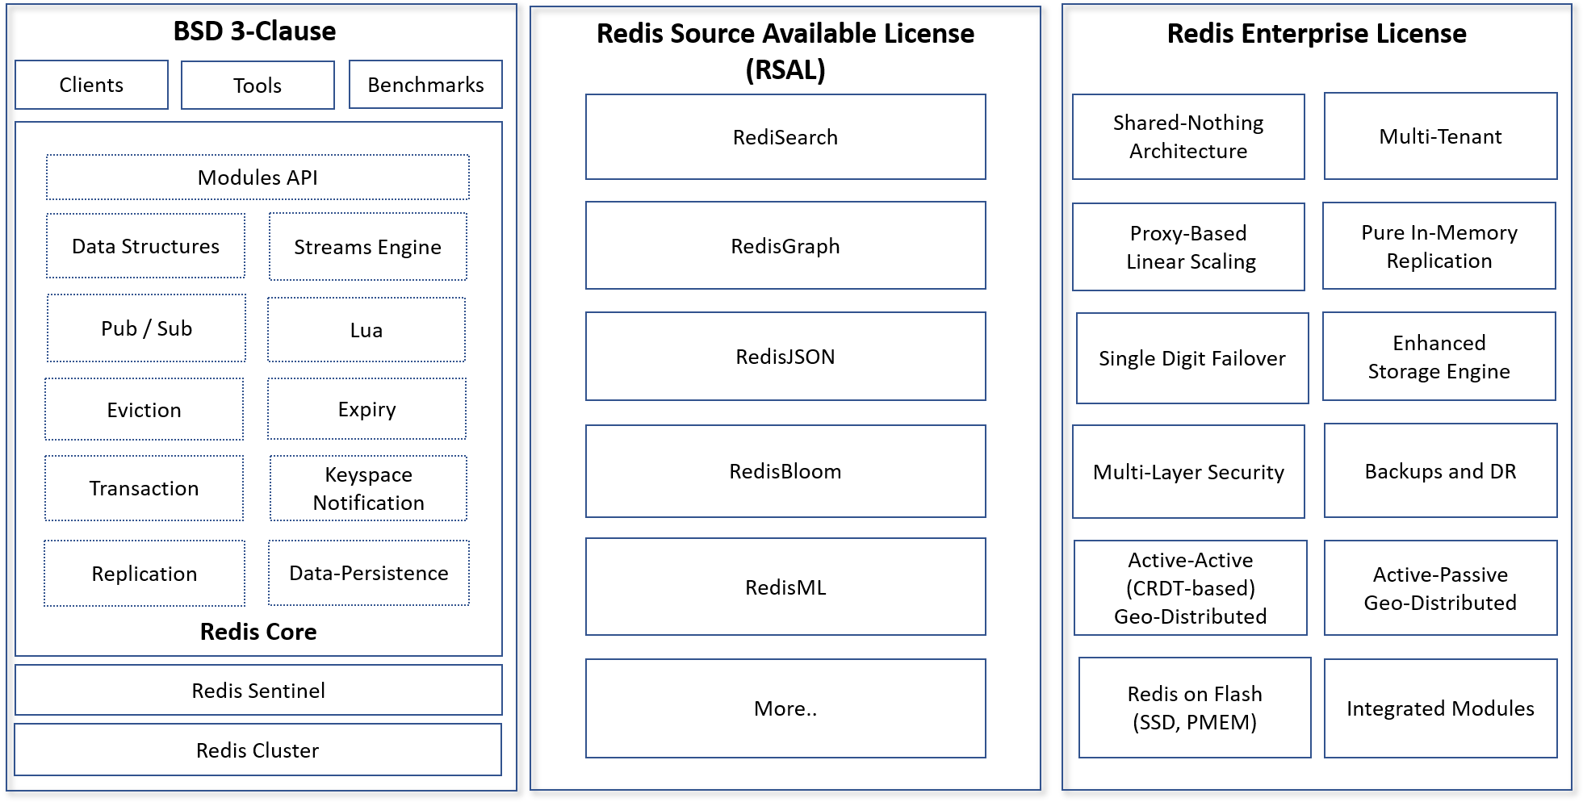
Redis After Licensing Change (AGPLv3 to RSAL) [1]
[1] https://redislabs.com/blog/redis-labs-modules-license-changes/

Slide 47
Triple-Licensing Components to Keep Competitors at Bay
Dual-Licensing
Triple-Licensing
Commercial license
Anti-competitor license
Anti-competitor license
Commercial license
AGPLv3
1
2
1
2
3

Slide 48
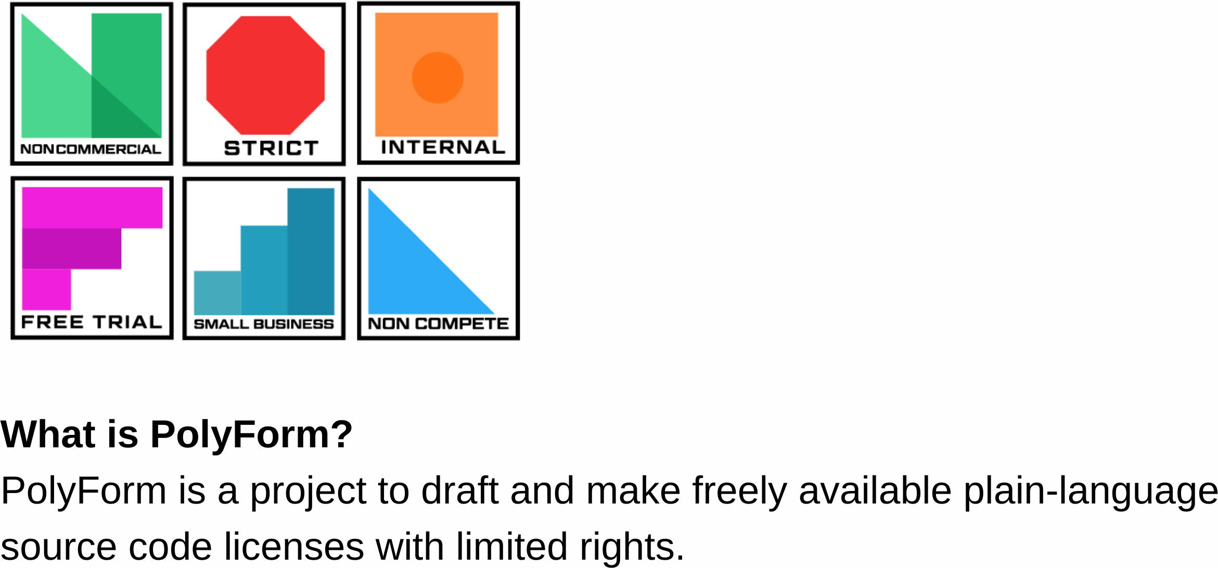
The Polyform Project [1]
[1] See https://polyformproject.org/

Slide 49
7. The Commercial Open Source Life-cycle

Slide 50
Product Life-cycle
Maturity
Growth
Launch
Ideation and
Development
End-of-life

Slide 51
Where New Features (Innovation) Goes
Closed features
Open source code
time
Project
Inception
Problem-
solution fit
Product-
market fit
Channel-
Product fit

Slide 52
Life-cycle of Single-Vendor Firms
Early years
  Full fair open source play
Growth years
  Full fair open source play
Maturity
  Increased closing of product

Slide 53
Summary
Product management in context
Software features
Feature differentiation
The open core model
IP rights management
Cloud computing challenges
Commercial open source life-cycle

Slide 54
Thank you! Questions?
dirk.riehle@fau.de – http://osr.cs.fau.de
dirk@riehle.org – http://dirkriehle.com – @dirkriehle
DR

Slide 55
Credits and License
Original version
  © 2020 Dirk Riehle, some rights reserved
  Licensed under Creative Commons Attribution 4.0 International License
Contributions
  None yet

